Slide 1

What is a macro?
A macro is a written set of instructions (program) that will perform actions in Excel when it runs. Similar to a recipe.
What is VBA?
VBA (Visual Basic for Applications) is the programming language we use to write macros.
ExcelCampus.com

Slide 2
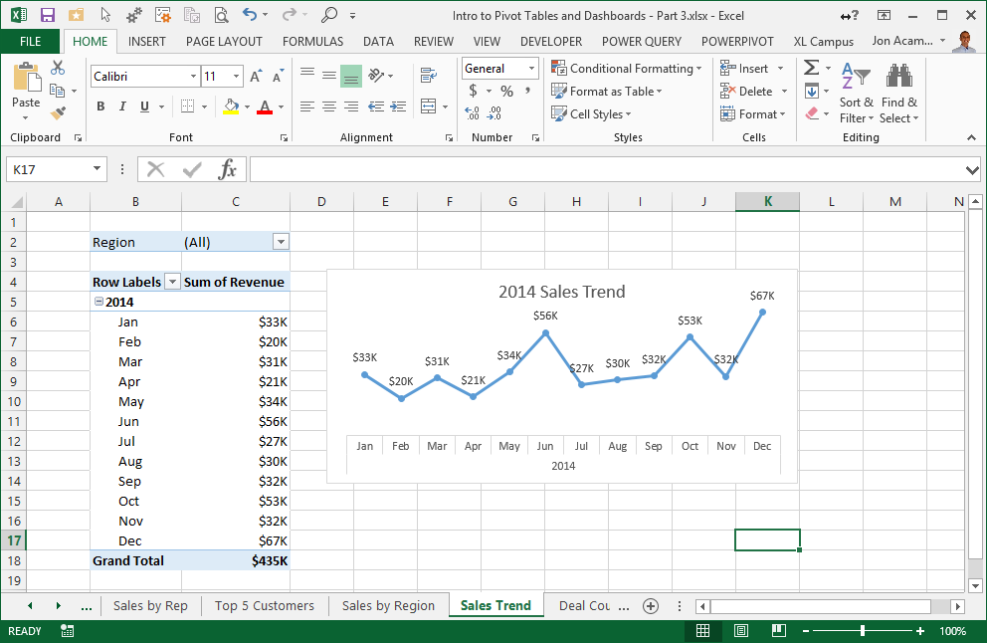
Everything in Excel is an Object
The Excel Object Model
ExcelCampus.com

Slide 3
All Objects have Properties and Methods (Actions)
Save
Width
Title
Copy
Select
Totals
Count
Move
ExcelCampus.com

Slide 4

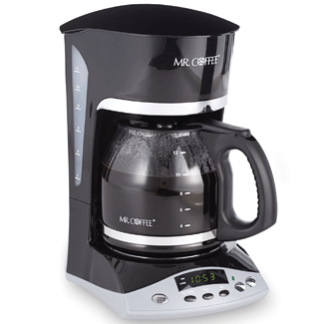
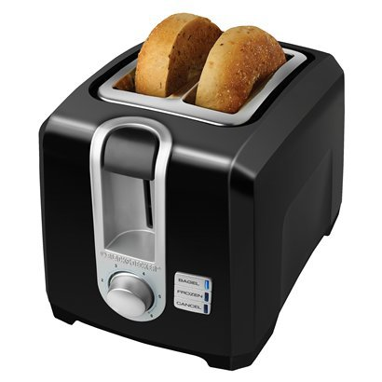
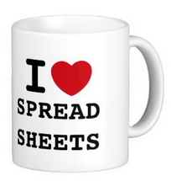
Kitchen Objects have Properties and Methods (Actions)
Fill
Length
Cut
Hot
Cook
Temperature
Sharp
Drink
Clean
Level
Brew
ExcelCampus.com

Slide 5
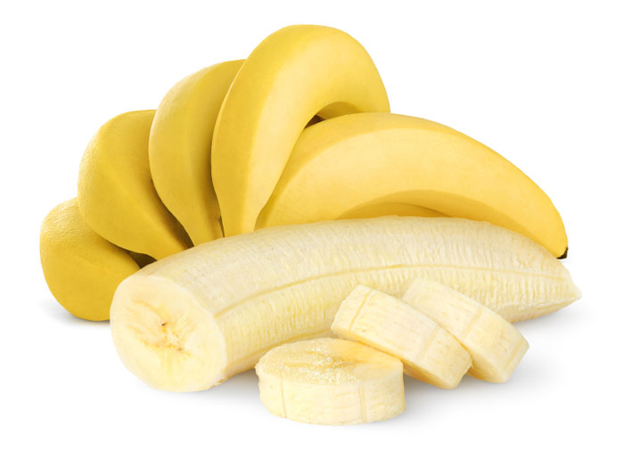
Write a Macro to Eat the Banana
Is it Ripe?
Read Properties to Make Decisions
Change/Set Properties
Take Actions (Methods)
Peel = False
Eat it!
ExcelCampus.com

Slide 6
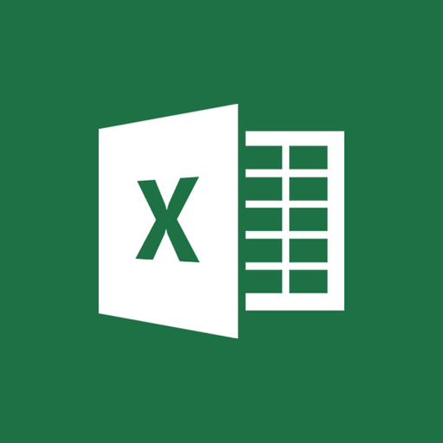
Add objects, properties, & methods to our macro

Slide 7
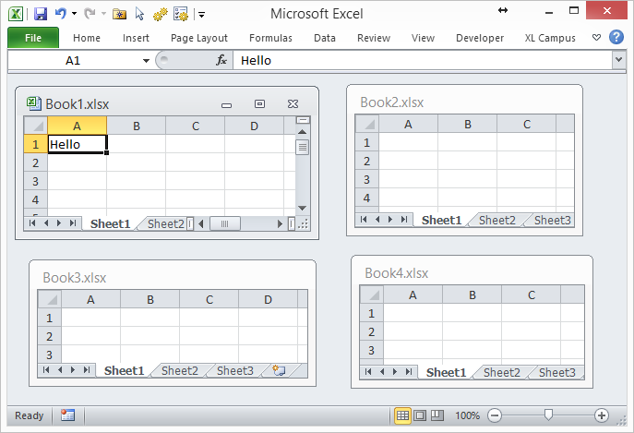
Referencing Excel Objects in VBA – The Object Hierarchy
Application
.Workbooks(“Book1.xlsx”)
.Worksheets(“Sheet1”)
.Range(“A1”)
ExcelCampus.com
Notes:
Finished

Slide 8
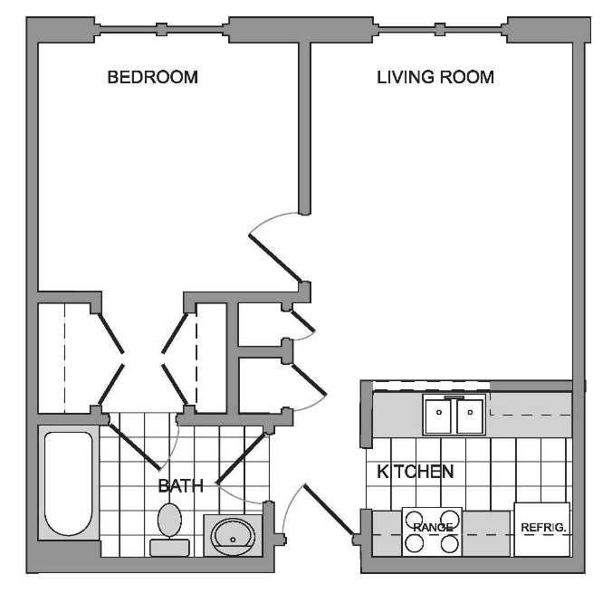



VBA Needs Context – Just Like Communicating with Family
"Can you turn the light on, please?"
ExcelCampus.com
Notes:
Finished

Slide 9


VBA Needs Context – Just Like Communicating with Family
Which light?
Floor lamp?
What room?
Wall switch?
Can lead to arguments…
In VBA: Errors & Disasters
"Can you turn the light on, please?"
ExcelCampus.com
Notes:
Finished

